Slide 1
DEVELOPING THE FUTURE OF ENERGY
OFS TRAINING ALL EMPLOYEES MEETING August 2026

Slide 2

AGENDA
McGinley
SAFETY MOMENT
Team Updates
Lizlee Galley
Leonardo Monzo
Johann Daxer
Julieta Ponce
Jim Rosen
Jen Wright
5S Moment
Andrew Samples
Business Update
Work Anniversaries
Cal McGinley
Cal McGinley
Q & A
Enter your questions in the Chat

Slide 3
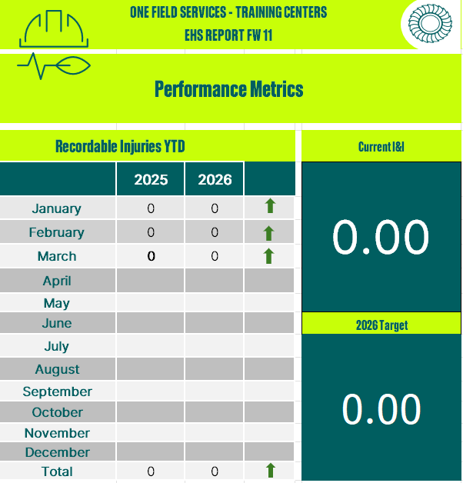
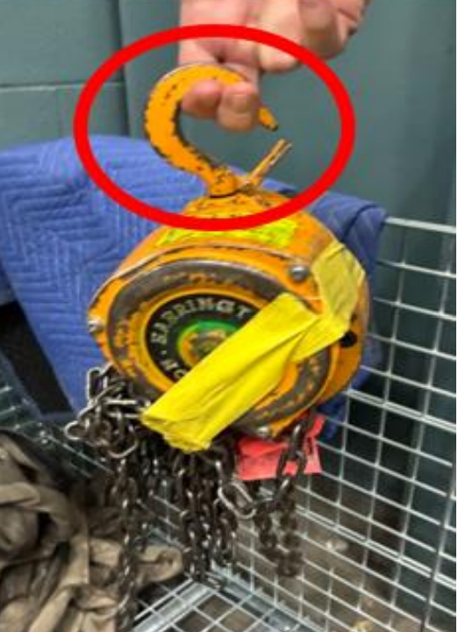
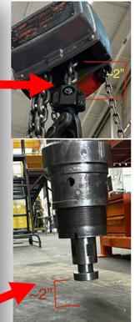
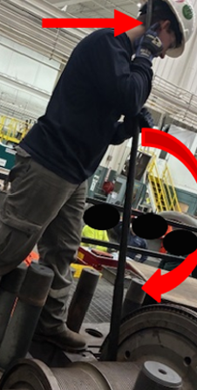
Q1 2026: EHS By The NUMBERS
Galley
Summary: Safety performance remained stable.
Incidence & Illness (I&I) rate change from 0.40 to 0.00
Near Misses (NM): 2 reported vs. zero in 2025
First Aid Injury (FAI): 1 vs zero in 2025.
Incident Overview:
Dropped objects involving rigging equipment from lifting operations
Use of mechanical tool VS non-powered hand tools.
Areas to improve:
Supervision during active operation of task/hands on training e.g., in a position to observe, intervene, immediately stop incorrect actions, challenge concerning decisions, or immediately able to control of the task/operation to prevent harm.
Compliance: forms reviewed by instructors not just checking the box.
Update this

Slide 4
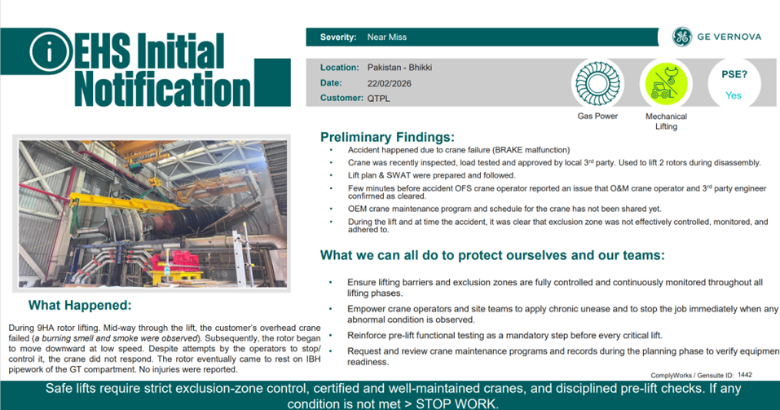
Galley
Update this

Slide 5
5S | Enterprise Momentum
Samples
A disciplined operating system accelerating SAFETY, EFFICIENCY, and CULTURAL OWNERSHIP
Update this
529 Event Attendees
WHAT WE’RE DOING
Unified global deployment
Monthly 5S events
Quarterly training sessions
Cross-functional participation
Staff Attendance
2025 11%
2026 54%
Culture scales when participation becomes visible
5S has moved beyond events and into an operating rhythm.
Notes:
What we’re doing
Coordinating efforts globally
5S events every month, at every site.
Partnering with the Aero Alliance Lean Team, for training events to educate Engineers and Craft.
Directors, PLLs, Managers, Team leaders, Office/Facilities staff, Instructors, Students, Full-time Contractors. All are involved.
Through Gemba walks and lunch & learn events we will reach our goal of 1000 event attendees in 2026
Staff attendance has increased year over year from 11% to 54% and rising.
Culture scales when participation becomes visible.
What do I mean by that ? Our organization’s values, behaviors, and positive habits, spread more effectively when people can clearly see others engaging in them.
The take-away banner- What started as the next new thing, is transforming into the norm.

Slide 6
Stop Work Recognition

Slide 7
5S (micro) KPI Dashboard
Samples
Gemba Walks 151/500
30%
Update this
Completed Projects 85/150
57%
Dead weight removed 47 tons/60 tons
78%
Liberated Space 7k SF/8k SF
88%
Progress is on-track to exceed expectations
Notes:
Leadership has high level KPIs. As you can see here, I have some low-level goals to drive progress.
We started strong, so now the aim is to surpass the original goals , then adjust accordingly for 2027.

Slide 8
The price of progress
Samples
Update this
Space
Time
Effort
Notes:
If you are familiar with gardening, you understand the term root bound. That is when a plant has outgrown its container. Its root system will have covered every square inch of the pot it’s in. We needed space to spread everything out and decide what to keep. Just like cleaning out your garage. You might cover the entire driveway with items, then once you cull the unnecessary and organize what remains, a true transformation has occurred.
Time is at a premium. With accelerating training demand, it is difficult to find the time we need. The teams stepped up and overcame the challenge. I don’t know how, but they make time.
Nothing worth doing is easy. The effort everyone has invested has and will continue to pay off.

Slide 9
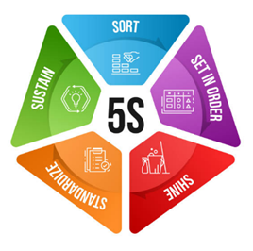

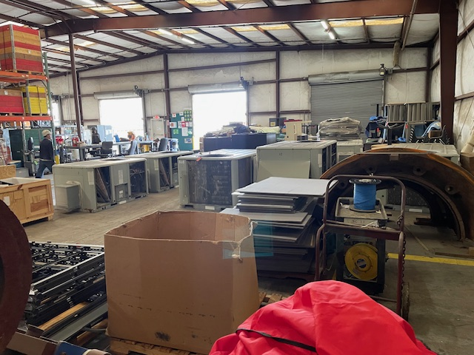
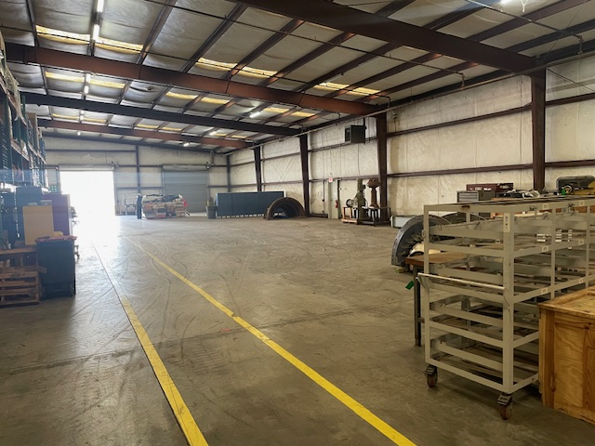
Samples
Title: Bldg.4 purge
Owner: Andrew Samples
Date Completed: March 2026
Problem Statement:
Update this
Corrective Action:
Bldg. 4 had become clogged with thousands of items. We had no immediate use for many of them. Some items had been stored for more than 9 years.
We engaged all site teams, gathered information about each item, then disposition them accordingly. *Phase 1, we removed 47 tons of and cleared 7k sq.ft of space. *Phase 2 will occur this quarter and generate additional gains.
As Found Photo
Completion Photo
Notes:
Building 4 is where we found the space we needed. It was packed to the gills.
Phase 1 (Q1 and Q2) focused on removing items that were obviously no longer needed, as well as cataloging and gathering the necessary details to make informed decisions about the remaining items.
Phase 2 (Q3) we’ll have a leadership review and retention decisions for the remaining inventory.
Phase 3 (Q4) create a digital inventory and introduce control process to protect the progress we’ve made.

Slide 10
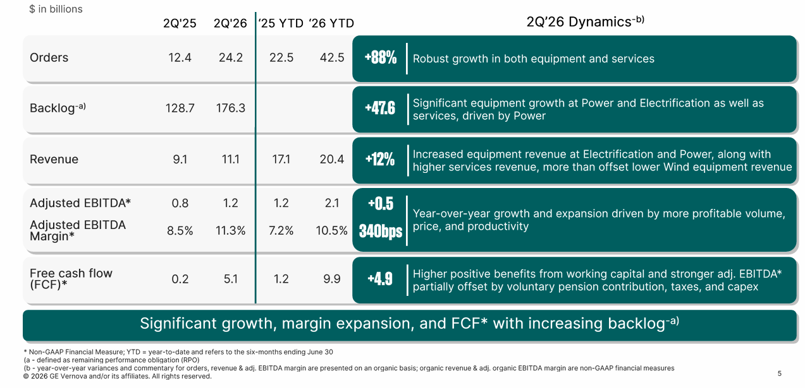
Business Update: Investor Call
McGinley

Slide 11
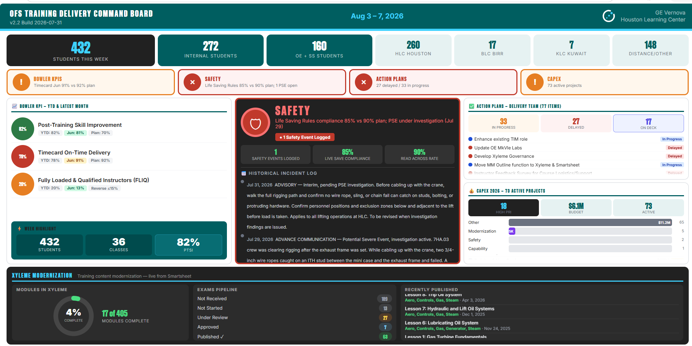
Other Business Stuff
McGinley
Workday Transition
Effects all FC employees
Band Mapping calls today please attend
Budget Cycle - Key Dates
OPEX final submissions – August 13th
CAPEX final Submissions – August 28th
OFS Training Delivery Command board is now live
OFS Training Delivery Command Board

Slide 12
Pedroza
Internal Training Q2 2026
CRAFT
FE
ALL
Summer Preparations
We have successfully aligned our logistics for upcoming major events and classes across the world.
Lean new tools development
Legislative Training in EU - Cost tracking
Document & Standardize Vendor Certificate Tracking & Processes Globally
Repairs Support Consolidation
Tools definition for each Training
FEP Cycle Time Optimization
We continually audit our processes, successfully identifying waste and reducing cycle times. These improvements are fully implemented, ensuring we are optimized to meet high demand.
OJT Feedback Process
We implemented a new OJT feedback loop, empowering mentees to help us optimize the training experience, particularly within the FEP program.
2027 Blueprint in process
All regions are actively gathering demand, analyzing performance gaps, and centralizing data to provide Finance with the insights needed for next year’s budget.
To ensure we secure the necessary funding for your team's new initiatives and prevent future course cancellations, please coordinate closely with the TDM team regarding any specific resource requirements.

Slide 13

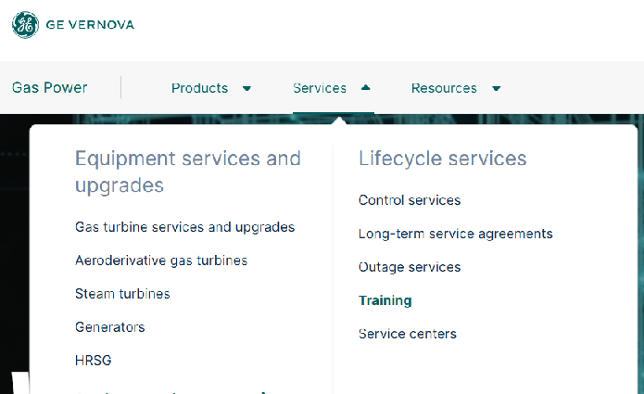
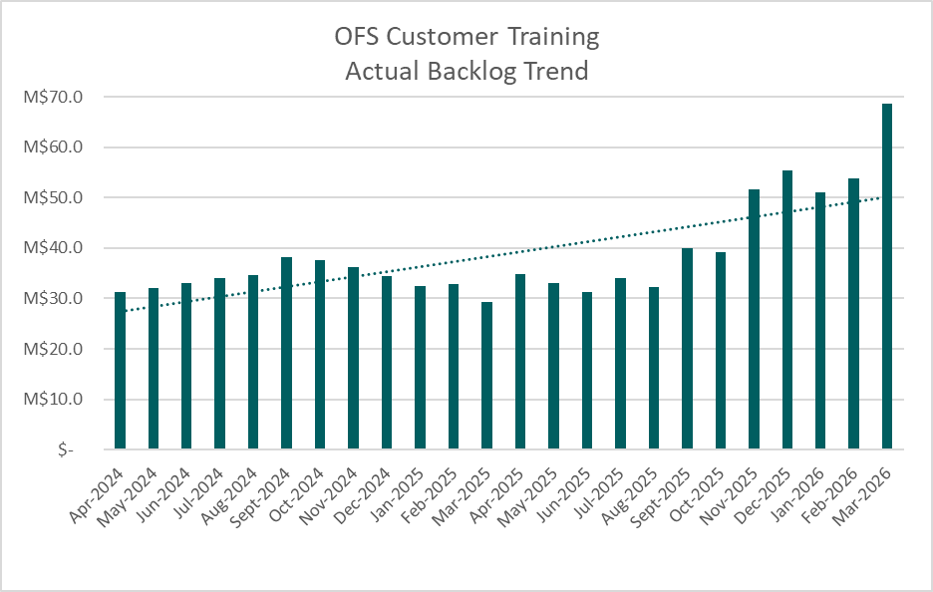
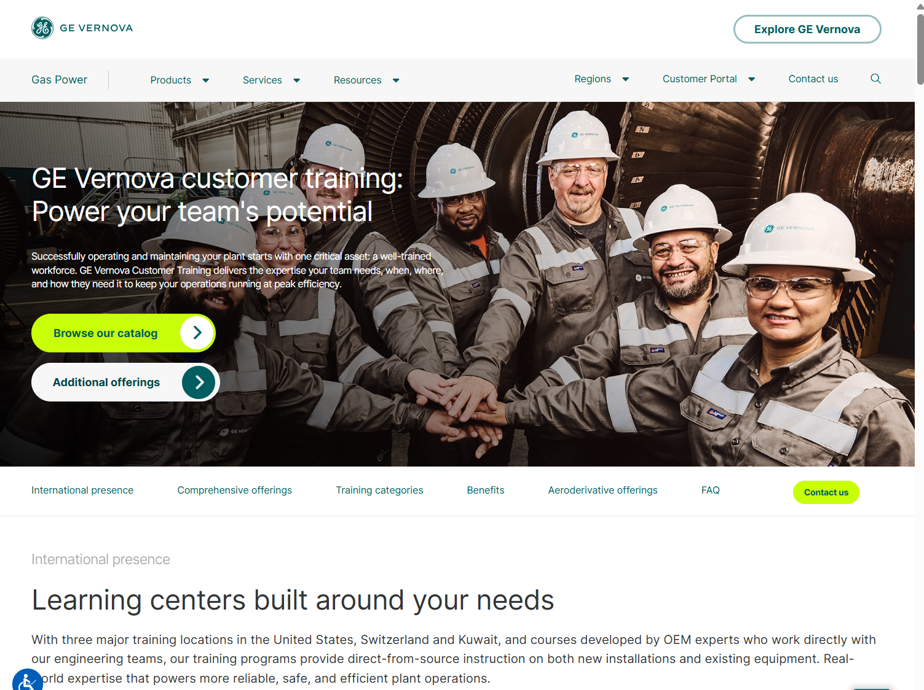
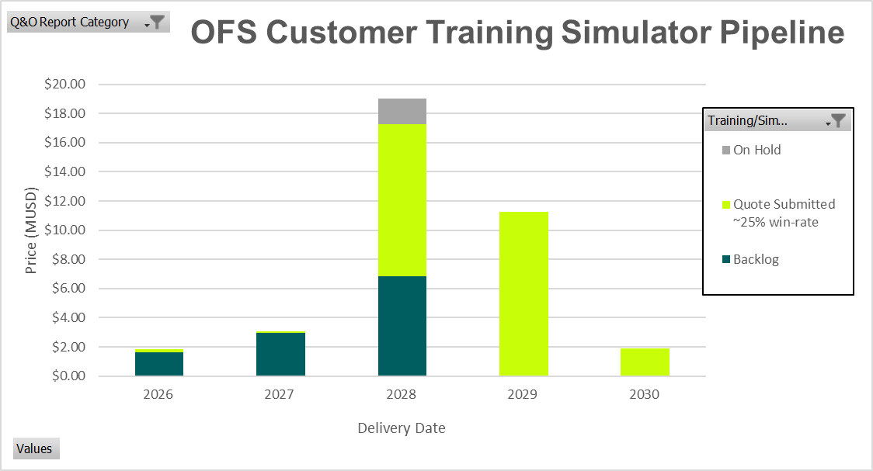

Daxer
Customer Training
Web presence @ GEV site
Update this
Increasing backlog trend: ~ +70%
Main driving regions: North America and Middle East
Latin America is increasing too
Asia and Europe on a constantly high level
Strong Simulator Growth w/ potential to accelerate once we offer Simulator supported Operator OJT
THANK YOU ALL FOR SUPPORTING & ENABLING US ☺

Slide 14
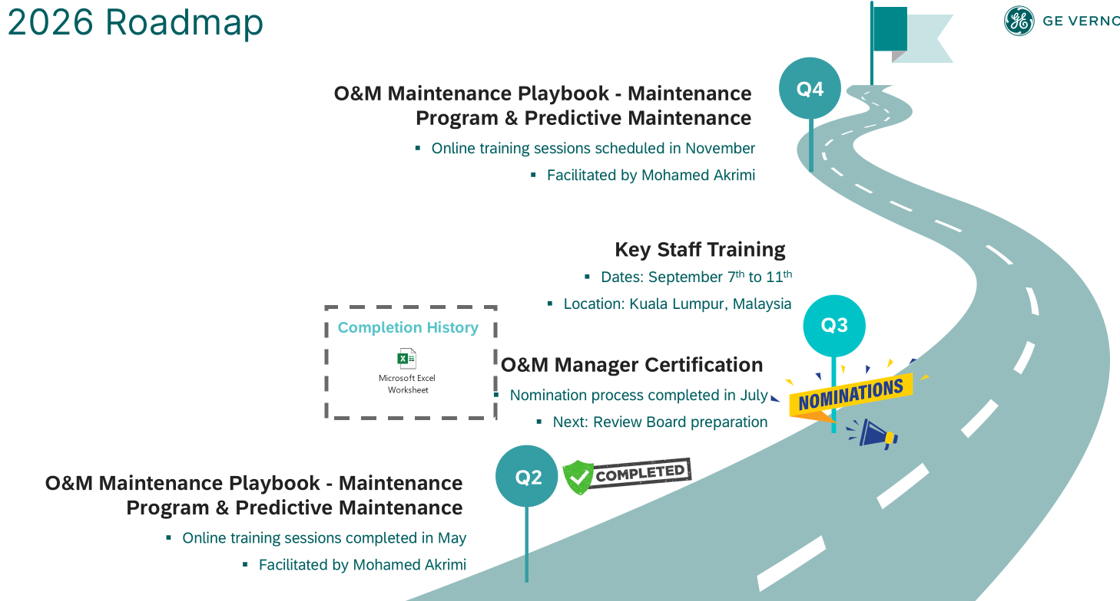
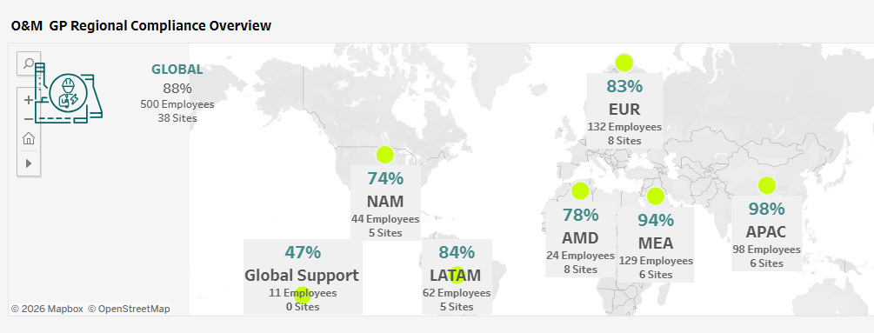
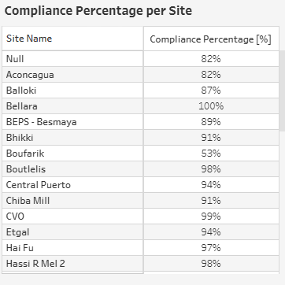
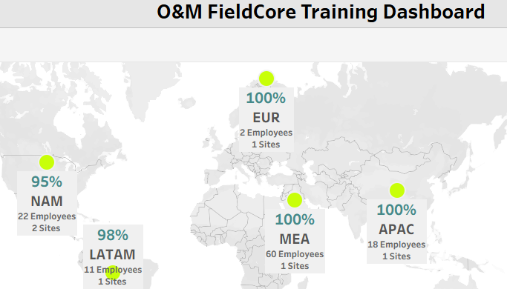
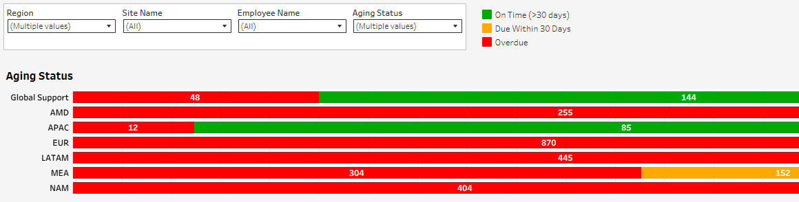

Programs & Competencies: 2026 O&M Roadmap and New Training Dashboard
Ponce
EMPLOYEES
SITES
615
39
Key Initiatives:
Special THANK YOU!
OT Cybersecurity curriculum update - Assigned to 316 GP employees across 37 sites + 78 FC employees across 6 sites (80% Completion)
HRSG Inspection Virtual Course - Budget approval pending
Warehouse & Logistics Program - 21 Sites surveyed
Simulator VILT - Target audience: 200 operators across 23 sites
Daniel Barrera

Slide 15


Technical Delivery
Rosen
Delivery
Capacity
Action Plan
CAPEX
Engagement
Focus
Delivered 100+ internal classes in 1Q26
Reached 1,040+ enrollments across 13+ locations plus distance learning
Covered the full OFS portfolio:
Ran multiple classes at or near capacity, with select offerings over-enrolled
Turned plans into field capability — and yes, the calendar survived
Put expanded HLC capacity to work immediately in 1Q26
Feb. 11 HLC event showcased the renovation and reinforced training as a business priority
Used upgraded spaces to support more learners, more programs, and stronger customer/leadership visibility
Improved instructor flow, student experience, and event hosting without slowing delivery
Proved this was more than a facelift — it increased usable delivery capacity
We currently have 58 AP items in progress, with 22 Technical Delivery
Another 60+ AP items are not started.
1Q also advanced major work already visible to the team: Gradebook rollout, updated Mk VIe labs, e-tools updates, controls room improvement planning, and HLC activation
Translation: the tracker is not just getting longer — it is getting more useful, more practical, and more connected to the work people feel every day
Backed the year with a $5.2M 2026 CAPEX budget for training
That is roughly 4x the 10-year average
Currently already $4.0M approved in POs, moving investment from talk to action
Funding supports lean tools, 7HA infrastructure, controls equipment updates, and continued HLC improvements
In real terms: we are buying now what would normally have been spread over the next four years
Service Week reflected the culture behind the work: one team, real contribution, real impact
Balanced community engagement, delivery commitments, and internal priorities in parallel
Sustained strong collaboration across portfolios, regions, and support teams
Kept energy high through a demanding quarter with a lot moving at once
Showed that engagement is not extra work — it is part of how we work
Built a strong 1Q foundation for the rest of 2026
Stayed focused on role-relevant, field-connected training that supports business demand
Continued improving how we deliver, not just what we deliver
Created momentum across delivery, facilities, processes, and investment
Started the year with proof: this team can scale, adapt, and deliver
Update this

Slide 16
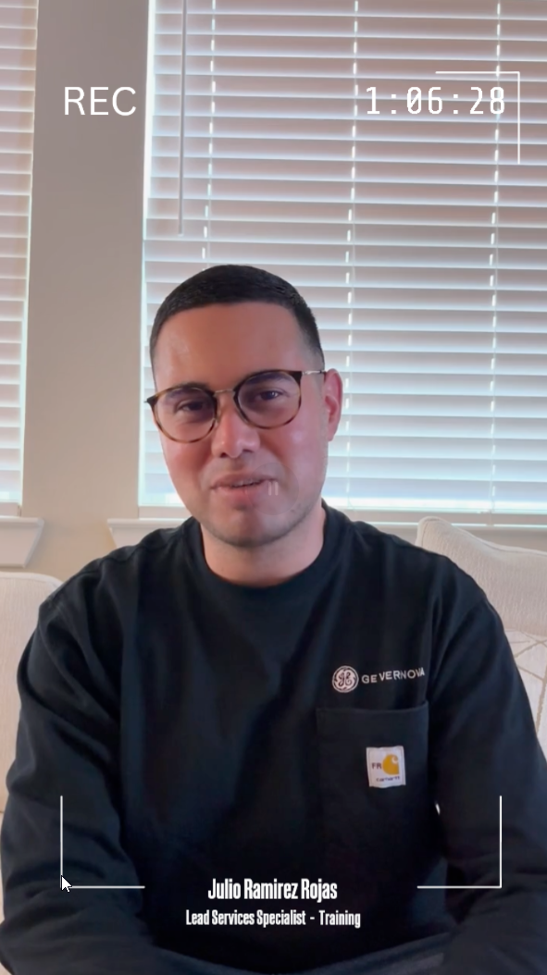
Training Ops: Xyleme Update – Excitation ELT Complete
Georga
Excitation ELT Complete
Course & Exams Transfer – Released Material
The Risks
100% Migrated into Xyleme
1 Global Source of Truth
100% Online Exam Delivery Enabled
3 Benefits Searchable • Reusable • Standardized Content
Current materials require cleanup before sharing with CT Team to start the process of migrating content into Xyleme.
40 Courses
ONE TEAM - OFS Instructors + Instructional Designers + Training Leadership collaborated to deliver the first fully migrated curriculum in Xyleme.
Keep in Mind
96 Exams
Content housed in Xyleme remains flexible and can be updated as needed.
It is a living resource that evolves with our training needs.
Content Transfer – Your actions
For a full Course
For Exams ONLY
1. Upload course content to the shared Box folder: _INBOX_Incoming Requests
2. Complete the Intake Request Form - Content Transfer
Upload course content to the shared Box folder:
Content Transfer - Exams
2. Complete the Exam Intake Request form
“Major step forward in standardization with the Entry Level Electrical and Excitation curriculum fully migrated and now being delivered from the Xyleme LCMS platform.”
Instructor Testimonial: Julio Ramirez Rojas
— Cal McGinley, Global Training Leader, OFS
© 2026 GE Vernova and/or its affiliates. All rights reserved.
1
Notes:
My presentation notes:
You may have noticed the title says'Xyleme Update: Excitation ELT Complete.’ but now you see something else. That was intentional. Before diving into the details, I wanted to highlight some statistics: 39 courses migrated, 82 exams enabled, and 100% online exam delivery through Xyleme. Those numbers speak for themselves.
Let's take a moment to celebrate this milestone. We've successfully completed the migration of the entire Excitation ELT curriculum into Xyleme, giving us one global source of truth for our content.This was a true One Team effort, bringing together instructors, instructional designers, and training leadership. The result is content that is searchable, reusable, and standardized, allowing us to deliver a more consistent learning experience around the world.
As we move forward, there is still work to do. Some existing materials will require cleanup before they can be transferred to the CT team for migration into Xyleme.
The good news is that Xyleme is a living resource. Content can be updated and improved over time, so we're not locked into static materials.
Your help is needed. Please upload content that you want to be transferred as IS to the designated Box folder and submit the Intake Request form. The same process applies for exam-only transfers using the Exams intake process.
Links are included.
I'd also like to recognize the positive feedback from Julio who delivered the EELT course among others via Xyleme, and echo Cal’smessage that this is a major step forward in training standardization.
Let’s see what Julio wants to share with us!
Click the Link to the video

Slide 17
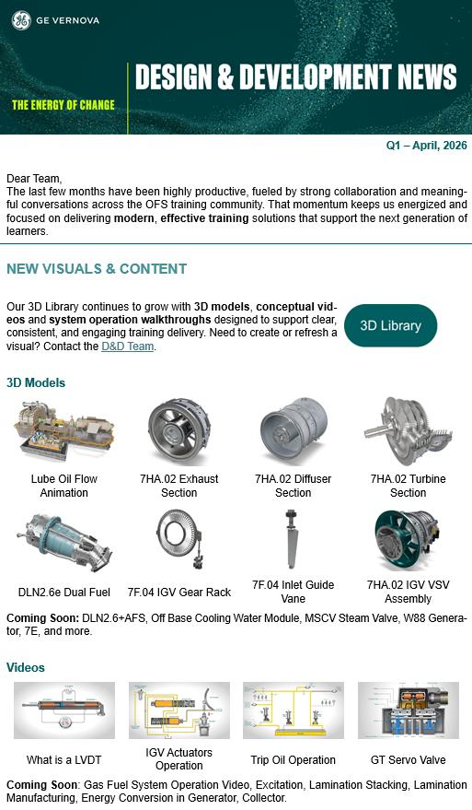
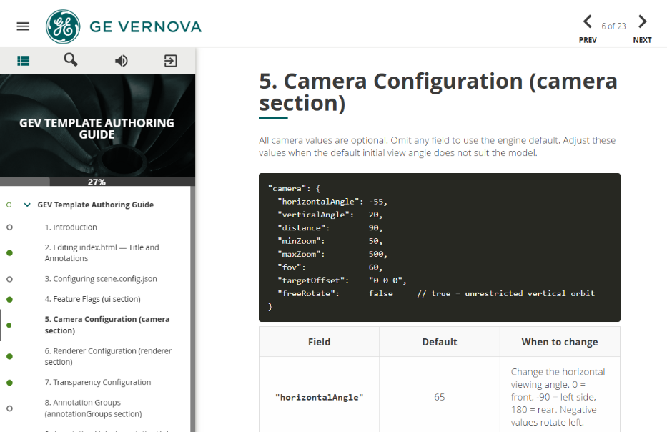
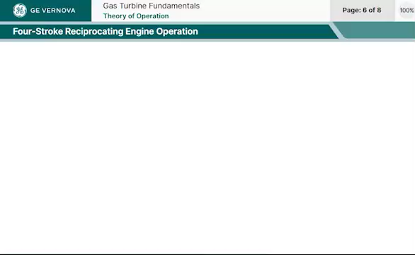
Training Ops: Content Updates
Fielding
Heavily working on evolving our development strategy, placing significant emphasis to improve consistency, efficiency, and scalability, on how our assets are structured and developed to support downstream applications and long-term maintainability.
Expanding GLB features for Field Procedures (assembly/disassembly) and AR implementation.
UI / UX Standards
D&D Newsletter
Coming very soon...
We haven’t forgotten you!
Flow Configuration Standards
Updating WBT Standards
Notes:
Notes: All 3D GLB content is aligned to industrial standards and classifications enabling complex functionality with minimum computer processing power needed – mobile phones, tablets, AR glasses.
All our standard publishing package files are now centralized ensuring simple maintenance and instant updates.
Working Instructions and Guidelines for these standards have been completed.
D&D News Letter... Waiting for some good model releases – we haven’t forgotten you. And AERO – we haven’t forgotten you too – traction is now picking up on the TM2500 and LM6000!

Slide 18
Work Anniversaries
McGinley
5 Years
Randall Stephenson
10 Years
Julieta Ponce
15 Years
Julio Ramirez
Lou Baez
20 Years
William Brown
Update this
Jen to send to ppl to make sure they’re ok with it
25 Years
Harry Hanson
35 Years
Tom Walsh

